Slide 1
TDD Development in Europe and Future Planning of 3.5GHz Spectrum
Jaime Afonso
ECC Vice-Chairman
The 5th TD-LTETechnology and Spectrum Workshop
Budapest, October 12th

Slide 2
Setting the scene
More than 1200 MHz available spectrum in Europe for wireless broadband: large contribution of 3.5 GHz band
Responding to data traffic growth
Key characteristic of the 3.5 GHz band
Large channel bandwidth
Deployment of dense and high date rate networks
Mobile/fixed networks
Service and technology neutrality

Slide 3
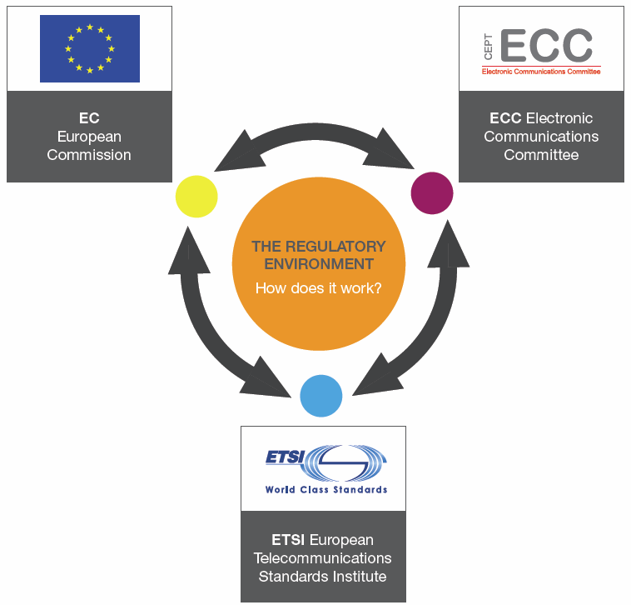
Harmonisation at CEPT level
Interaction with stakeholders is key
The 3.5 GHz band in CEPT
Initial discussion: more than 10 years ago!
Evolving requirements
FWA/BWA
Flexible use (e.g. backhaul)
Block Edge Mask (BEM)

Slide 4
The 3.5 GHz band plans
Sharing and compatibility studies
Other users needs (e.g. FSS downlink, fixed service)
Different situation of 3.4 – 3.6 GHz vs 3.6 – 3.8 GHz
TDD vs FDD
Band plans (ECC Decision (11)06)
TDD (preferred)
TDD

Slide 5
Implementation of the 3.5 GHz band
The (least restrictive) Technical Conditions
Suitable for IMT
Synchronisation: ECC Report 216
Is it possible to improve the 3.6-3.8 GHz situation ?
Consideration of other existing and planned usage
Best practices national sharing framework and LSA

Slide 6
The future of the 3.5 GHz
Challenges
Legacy issues
Market demand
EU (worldwide?) harmonisation measures
Expectations of the 3.5 GHz band
Have not materialized (yet?)
How/when to encompass 5G?

Slide 7
More information at
www.cept.org/ecc
Thank you!
The 5th TD-LTETechnology and Spectrum Workshop
Budapest, October 12th

